Slide 1
Fundamentals of Plastic Deformation of Metals

Slide 2
Elastic Deformation vs Plastic Deformation
Metallic materials may experience two kinds of deformation: Elastic and Plastic
Nonpermanent: When the applied load is released, the piece returns to its original shape
Permanent
On an atomic scale, Small changes in the interatomic spacing and the stretching of interatomic bonds
Net movement of large numbers of atoms in response to an applied stress. Interatomic bonds must be ruptured and then reformed.
1
2

Slide 3
Elastic Deformation vs Plastic Deformation
3
Elastic modulus or stiffness is the material’s resistance to elastic deformation. The greater the modulus, the stiffer the material, or the smaller the elastic strain that results from the application of a given stress.
Strength and hardness are measures of a material’s resistance to plastic deformation.

Slide 4
Plastic Deformation
Plastic deformation corresponds to the motion of large numbers of dislocations.
Let’s see what happens when one dislocation is created and moves

Slide 5
Dislocation Motion
Shift of the upper half of the crystal after the dislocation emerged
Generation of an edge dislocation by a shear stress
Movement of the dislocation through the crystal

Slide 6
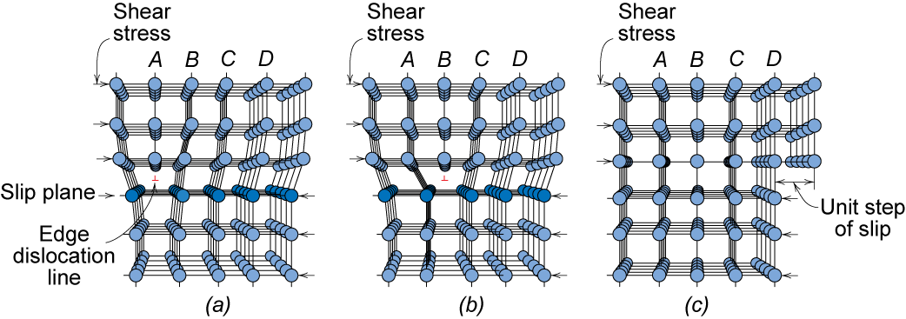
Dislocation Motion
Dislocations & plastic deformation
Plastic deformation by plastic shear or slip where one plane of atoms slides over adjacent plane by defect motion (dislocations).
If dislocations don't move, deformation doesn't occur!

Slide 7
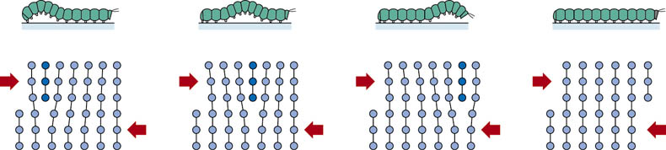
f03_07_pg177
Analogy between caterpillar and dislocation motion
Notes:
f03_07_pg177.jpg

Slide 8
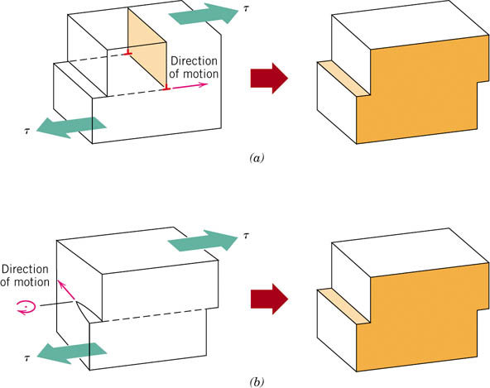
f02_07_pg177
Dislocation Motion
The formation of a step on the surface of a crystal by the motion of
(a) an edge dislocation
The dislocation line moves in the direction of the applied shear stress
(b) a screw dislocation
The dislocation line motion is perpendicular to the stress direction.
The direction of motion of the mixed dislocation line is neither perpendicular nor parallel to the applied stress, but lies somewhere in between
Notes:
f02_07_pg177.jpg

Slide 9
Dislocation Density
Dislocations are introduced during solidification, during plastic deformation, and as a consequence of thermal stresses that result from rapid cooling.
Dislocation density is expressed as the total dislocation length per unit volume, or, equivalently, the number of dislocations that intersect a unit area of a random section.
The units of dislocation density are millimeters of dislocation per cubic millimeter or just per square millimeter.

Slide 10
Dislocation Density
Carefully solidified metal crystals: 10³ mm⁻²
Heavily deformed metals: 10⁹ to 10¹⁰ mm⁻².
(Important source of these new dislocations: 1) existing dislocations, which multiply; 2) grain boundaries, 3) internal defects and surface irregularities such as scratches and nicks, which act as stress concentrations)
Heat treating a deformed metal specimen can diminish the density to on the order of 10⁵ to 10⁶ mm⁻².
Ceramic materials: 10² - 10⁴ mm⁻²
Silicon single crystals used in integrated circuits:
0.1 -1 mm⁻².

Slide 11
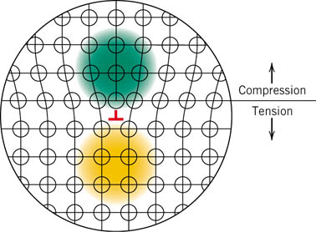
f04_07_pg178
Strain Energy
When metals are plastically deformed, some fraction of the deformation energy (approximately 5%) is retained internally; the remainder is dissipated as heat.
The major portion of this stored energy is as strain energy associated with dislocations.
Notes:
f04_07_pg178.jpg

Slide 12
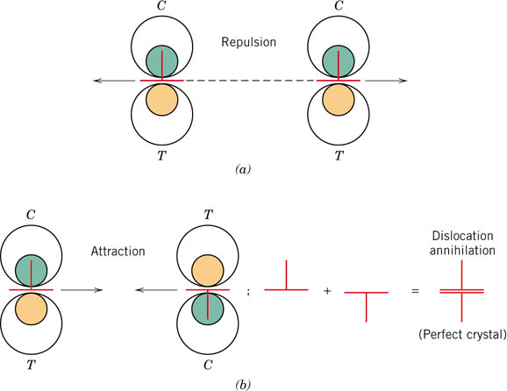
f05_07_pg179
Strain fields and associated forces
Important in the strengthening mechanisms for metals.
Notes:
f05_07_pg179.jpg

Slide 13
Dislocation Movement and Slip
There are two basic types of dislocation movements:
Glide: Dislocation moves in the plane which contains both its line and Burgers vector
Climb: Dislocations moves out of the glide plane normal to the Burgers vector
Glide of many dislocations result in Slip
Slip: Most common manifestation of plastic deformation in crystalline solids

Slide 14
Slip System: Slip Plane + Slip Direction
Glide of dislocations occurs not with same degree of easiness on all crystallographic planes of atoms and in all crystallographic directions.
Preferred plane, and in that plane specific directions along which dislocation glide occurs.
This plane is called the slip plane;
The direction of movement is called the slip direction.
This combination of the slip plane and the slip direction is termed the slip system.

Slide 15
Slip System: Slip Plane + Slip Direction
The slip system depends on the crystal structure of the metal and is such that the atomic distortion that accompanies the motion of a dislocation is a minimum.
For a particular crystal structure, the slip plane is that plane having the most dense atomic packing
The slip direction corresponds to the direction, in this plane, that is most closely packed with atoms, that is, has the highest linear density.

Slide 16
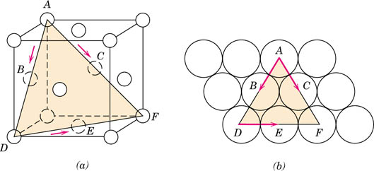
f06_07_pg180
Slip System in FCC
Slip occurs along <110>-type directions within the {111} planes
{111}<110> represents the slip plane and direction combination, or the slip system for FCC.
There are 4 close-packed planes {111} with 3 close-packed directions in each plane < 110 >
– a total of 12 slip systems.
Notes:
f06_07_pg180.jpg

Slide 17
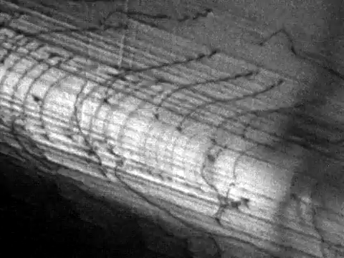

Slide 18
Slip Systems in BCC
No close-packed plane, but close-packed directions < 111 >
Three types of planes which are nearly tied for the highest packing density.
near close - packed planes in BCC : {110} {321} {211}
All these planes have been observed to be slip planes.
Thus we have the following slip systems in BCC crystals:
• 6 {110} planes each with 2 < 111 > directions = 12 slip systems
• 24 {321} planes each with 1 < 111 > direction = 24 slip systems
• 12 {211} planes each with 1 < 111 > direction = 12 slip systems

Slide 19
Slip Systems in HCP
The basal plane (0001) is the close-packed plane and there are 3 close-packed directions < 1120 >
There can be other slip systems in HCP called Prism slip {1010} and Pyramid slip {1011}. Slip direction will remain the close packed <1120> direction

Slide 20
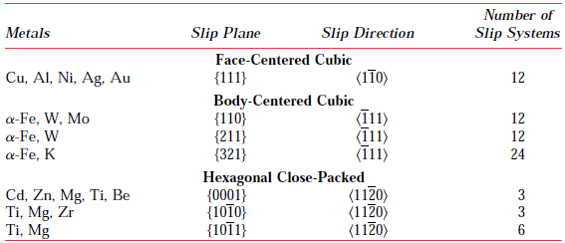
Slip System for FCC, BCC and HCP Metals
FCC or BCC: Relatively large number of slip systems (at least 12).
These metals are quite ductile because extensive plastic deformation is normally possible along the various systems.
HCP metals, having few active slip systems, are normally quite brittle.

Slide 21
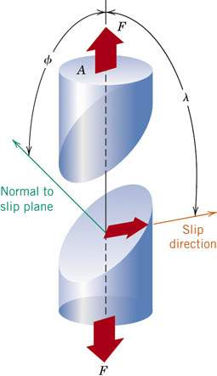
Slip in a single crystal
Applied tensile
Resolved shear
stress:
σ
= F/A
stress:
τ_{R}
=
F
s
/A
s
F
slip plane
normal, n_{s}
A
τ_{R}
A_{S}
F_{S}
slip
direction
slip
direction
F
τ_{R}
τ_{R}
=
F_{S}
/A_{S}
F
cos
λ
A
/
cos
φ
Relation between
F
n_{S}
φ
slip
direction
λ
σ
and
τ_{R}
A
F_{S}
A_{S}

Slide 22
Deformation in Single Crystal
A metal single crystal has a number of different slip systems that are capable of operating. The resolved shear stress normally differs for each one because the orientation of each relative to the stress axis (φ and λ angles) also differs.
However, one slip system is generally oriented most favorably, that is, has the largest resolved shear stress, τ_{R}(max): τ_{R}(max) = σ(cos φ cos λ)_{max}

Slide 23
Slip in Single Crystal
In response to an applied tensile or compressive stress, slip in a single crystal commences on the most favorably oriented slip system when the resolved shear stress reaches some critical value, termed the critical resolved shear stress τ_{crss}
τ_{crss} represents the minimum shear stress required to initiate slip
τ_{crss} is a property of the material that determines when yielding occurs.
The single crystal plastically deforms or yields when τ_{R}(max) = τ_{crss}

Slide 24

Slip in single crystal
The single crystal plastically deforms or yields when τ_{R}(max) = τ_{crss}
The magnitude of the applied stress required to initiate yielding (i.e., the yield strength σ_{y}) is
The minimum stress necessary to introduce yielding occurs when a single crystal is oriented such that φ=λ=45⁰; under these conditions, σ_{y} = 2 τ_{crss}

Slide 25
Critical Resolved Shear Stress
• Condition for dislocation motion:
• Crystal orientation can make
it easy or hard to move dislocation
typically
10⁻⁴ GPa to 10⁻² GPa
σ
σ
σ
τ_{R}
= 0
τ_{R}
=
σ
/2
τ_{R}
= 0
λ
=90°
λ
=45°
φ
=90°
φ
=45°
τ maximum at λ = φ = 45º

Slide 26
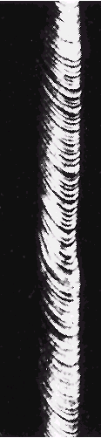
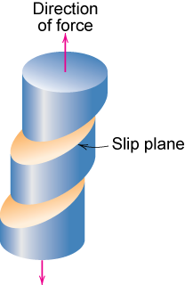
Single Crystal Slip

Slide 27
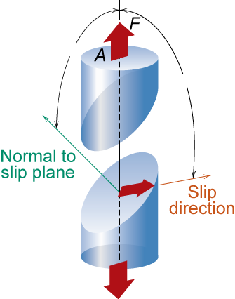
Ex: Deformation of single crystal
a) Will the single crystal yield?
b) If not, what stress is needed?
φ=60°
τ_{crss} = 3000 psi
λ=35°
σ = 6500 psi
So the applied stress of 6500 psi will not cause the crystal to yield.

Slide 28
Ex: Deformation of single crystal
What stress is necessary (i.e., what is the yield stress, σ_{y})?
So for deformation to occur the applied stress must be greater than or equal to the yield stress

Slide 29
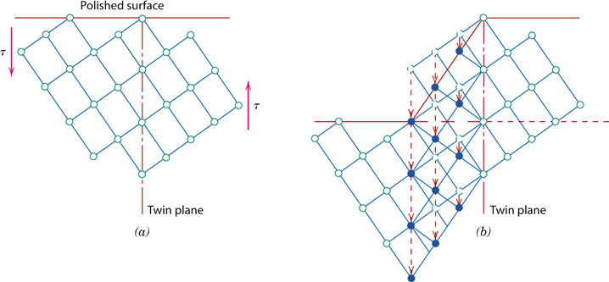
f12_07_pg187
Deformation by Twining
Plastic deformation in some metallic materials can occur by the formation of mechanical twins, or twinning
A shear force can produce atomic displacements such that on one side of a plane (the twin boundary), atoms are located in mirror image positions of atoms on the other side.
Notes:
f12_07_pg187.jpg

Slide 30
Deformation by Twining
The displacement magnitude within the twin region (indicated by arrows) is proportional to the distance from the twin plane.
Twinning occurs on a definite crystallographic plane and in a specific direction that depend on crystal structure.
For BCC metals, the twin plane and direction are (112) and [111], respectively

Slide 31
Deformation by Twining
Mechanical twinning occurs in metals that have BCC and HCP crystal structures, at low temperatures, and at high rates of loading (shock loading), conditions under
which the slip process is restricted; that is, there are few operable slip systems.
The amount of bulk plastic deformation from twinning is normally small relative to that resulting from slip.
The real importance of twinning lies with the
accompanying crystallographic reorientations; twinning may place new slip systems in orientations that are favorable relative to the stress axis such that the slip process can now take place.

Slide 32
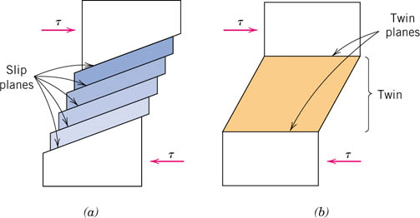
f13_07_pg187
Comparison between Slip and Twin
Slip Ledges form
The crystallographic orientation above and below the slip plane is the same both before and after the deformation
Occurs in distinct atomic spacing multiples
Shear deformation is homogeneous
A reorientation across the twin plane
The atomic displacement for twinning is less than the interatomic separation
Notes:
f13_07_pg187.jpg

Slide 33
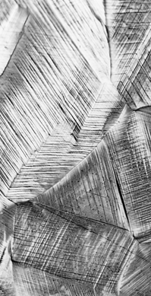
Slip Motion in Polycrystals
σ
Random crystallographic orientations of the numerous grains
The direction of slip varies from one grain to another
For each grain, dislocation motion occurs along the slip system that has the most favorable orientation (i.e., the highest shear stress)
300 μm

Slide 34
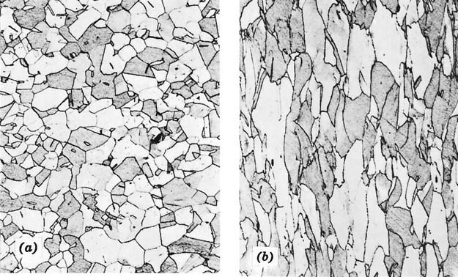
f11_07_pg186
Deformation in polycrystals
During deformation, mechanical integrity and coherency are maintained along the grain boundaries → the grain boundaries usually do not come apart or open up. →
each individual grain is constrained, to some degree, in the shape it may assume
by its neighboring grains.
Equiaxed grains
Elongated grains
Even though a single grain may be favorably oriented with the applied stress for slip, it cannot deform until the adjacent and less favorably oriented grains are capable of slip also; this requires a higher applied stress level.
Notes:
f11_07_pg186.jpg

Slide 35
Strengthening Mechanisms
ISSUES TO ADDRESS...
• How do we increase strength?
• Strength is increased by making dislocation
motion difficult.
• Particular ways to increase strength are to:
--solid solution strengthening
--Strain hardening/ Work hardening/ Cold work
--precipitation hardening
--decrease grain size

Slide 36
Strengthening Mechanisms

Slide 37
Strengthening Mechanisms :
Solid Solution Strengthening
Strain Hardening
Precipitation Hardening
Grain Boundary Strengthening

Slide 38
Strengthening Mechanisms :
Solid Solution Strengthening
Strain Hardening
Precipitation Hardening
Grain Boundary Strengthening

Slide 39
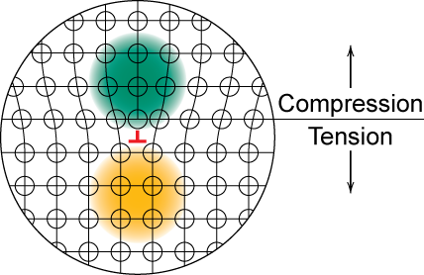
Stress Concentration at Dislocations
Strengthening by Alloying
Adapted from Fig. 7.4, Callister 7e.
Notes:
Don’t move past one another – hardens material

Slide 40
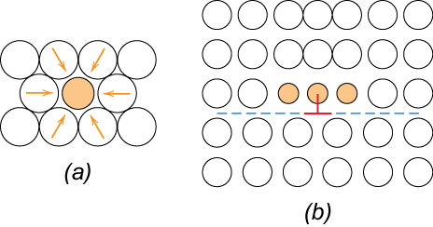
Strengthening by Alloying
small impurities tend to concentrate at dislocations on the “Compressive stress side”
reduce mobility of dislocation ∴ increase strength
Adapted from Fig. 7.17, Callister 7e.

Slide 41
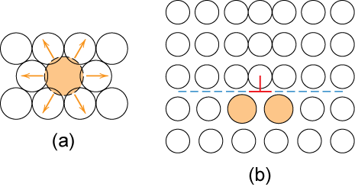
Strengthening by alloying
Large impurities concentrate at dislocations on “Tensile Stress” side – pinning dislocation
Adapted from Fig. 7.18, Callister 7e.

Slide 42
Example: Solid Solution Strengthening in Copper
• Tensile strength & yield strength increase with wt% Ni.
180
400
120
Tensile strength (MPa)
Yield strength (MPa)
300
200
60
0
10
20
30
40
50
0
10
20
30
40
50
wt.% Ni
wt.%Ni
• Empirical relation:
• Alloying increases σ_{y} and TS.

Slide 43
Strengthening Mechanisms :
Solid Solution Strengthening
Strain Hardening
Precipitation Hardening
Grain Boundary Strengthening

Slide 44
Strengthening through Strain hardening
Phenomenon whereby a ductile metal becomes harder and stronger as it is plastically deformed
• Also called Work hardening
Also termed as Cold working: Because, the temperature at which deformation takes place is ‘‘cold’’ relative to the absolute melting temperature of the metal
Most metals strain harden at room temperature
Often utilized commercially to enhance the mechanical properties of metals during fabrication procedures.

Slide 45
Strengthening through Strain hardening
Common forming operations change the cross sectional area:
-Forging
force
-Rolling
die
roll
A
d
A
o
blank
A
d
A
o
roll
force
-Drawing
-Extrusion
A
o
die
A
d
container
die holder
A
tensile
force
o
force
ram
billet
extrusion
A
d
die
container
die
Percentage Cold Work

Slide 46
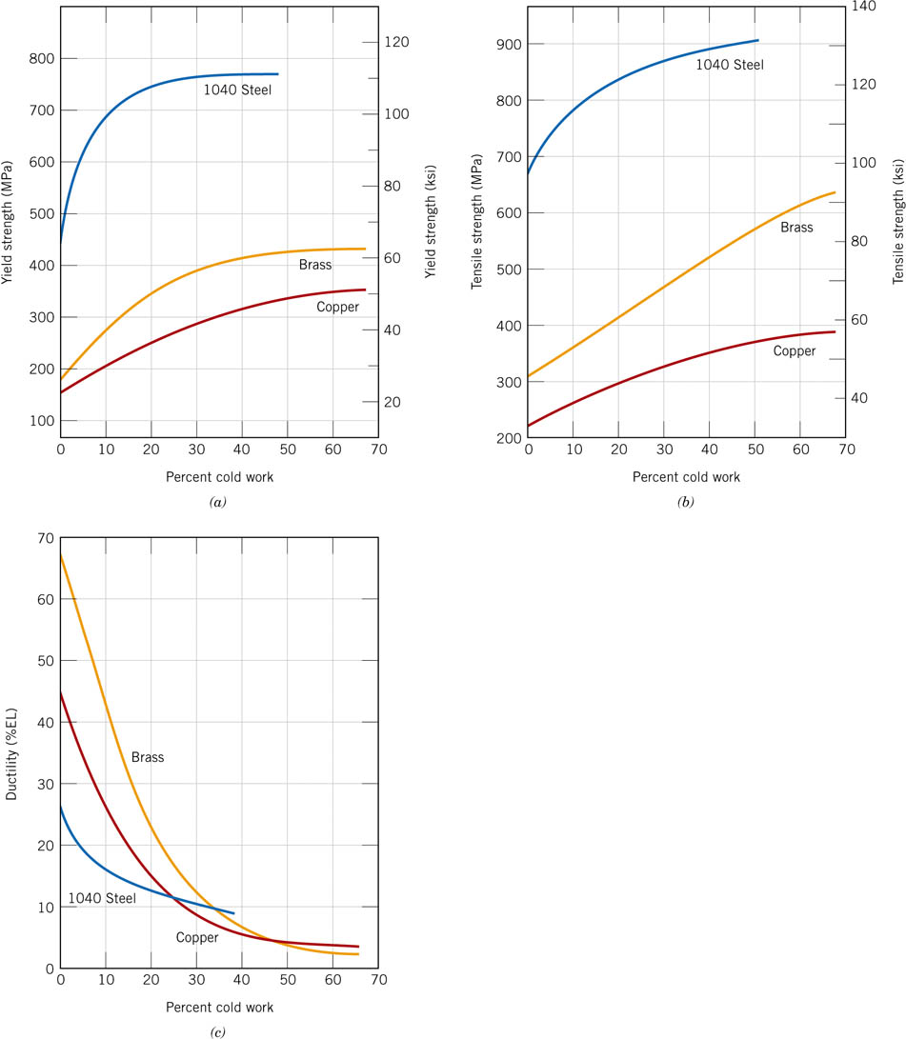
f19_07_pg192
Examples
Notes:
f19_07_pg192.jpg

Slide 47
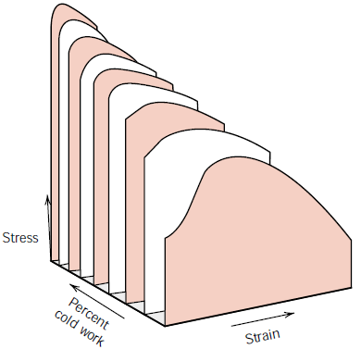
Example: Strain hardening
Low Carbon Steel

Slide 48
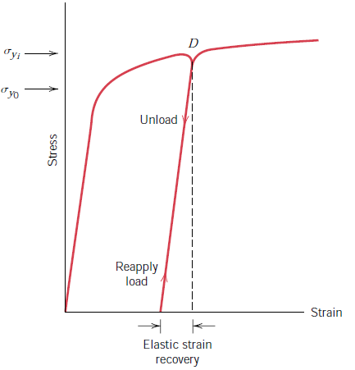
Example:
Strain hardening effect on Stress-Strain Diagram

Slide 49
Why materials strain harden?
Dislocation–dislocation strain field
On the average, dislocation–dislocation strain interactions are repulsive → The motion of a dislocation is hindered by the presence of other dislocations.
Cold work → Formation of new dislocations → The dislocation density in a metal increases
As the dislocation density increases, the resistance to dislocation motion by other dislocations becomes more pronounced.
Thus, the imposed stress necessary to deform a metal increases with increasing cold work.

Slide 50
Strengthening Mechanisms :
Solid Solution Strengthening
Strain Hardening
Precipitation Hardening
Grain Boundary Strengthening

Slide 51
Cutting precipitates:
When too small - dislocations can cut them:

Slide 52
Bowing:
dislocations bow past
precipitates
precipitates
slow dislocations
τ_{y} = Gb / L

